Slide 1
Aquifer Testing

Slide 2
Purpose
WHY—Can’t stick a flow meter in ground
See responses to flow
  Slug—Connection of well & aquifer
  Pumping—Connection between wells
Estimate representative hydraulic properties
  Transmissivity (T) for all types of analyses
  Storage coefficient (S) if multiple well
  T & S knowable because flow rate (Q) known
Area investigated
  Volume of pumped water

Slide 3
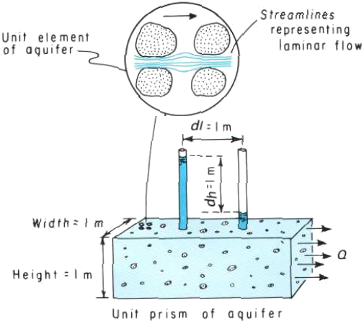
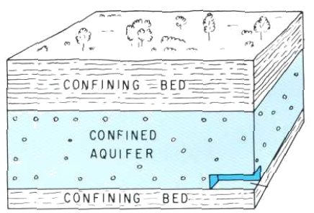
Hydraulic Conductivity (K)
Mr. Darcy’s fudge factor or
truth coefficient
Accounts for
  Permeability of rock
  Viscosity of water
  Gravity, being on Earth
Minor problems from lumping
Relates flow to head drop
For a given head difference,
  Double K
  Double flow (Q)
K not a useful term in practice
(Modified from Heath, 1983)

Slide 4

Transmissivity (T)
Transmissivity is
hydraulic conductivity (K)
x thickness (b)
Thickness not always known
Transmissivity (T)
  Estimated from aquifer tests
  Easy to apply to X-section
  Easily mapped
T less variable than K x b
  Analogous to weight of passengers on plane
Surface Trace
Cross Section

Slide 5
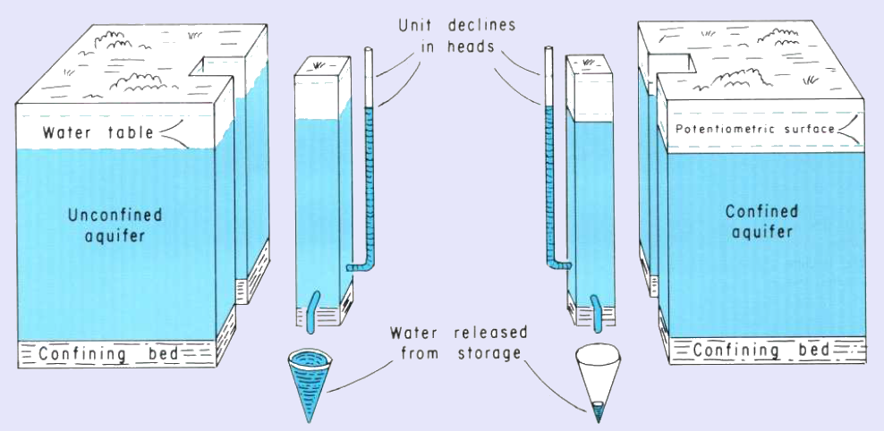
Storage Coefficient (S)
(Heath, 1983)
Specific yield—Drainable water, Long term (years) source
  Basin Fill 0.10 to 0.20, fraction
  Fractured Rock 0.01 to 0.04, fraction
Confined—Thickness x compressibility, 0.0002 to 0.002
  Compressibility, specific storage ~ 2 x 10⁻⁶ 1/ft, not variable

Slide 6
Slug Tests

Slide 7
Uses
Local estimate of transmissivity across well screen, K = T/b_{screen}
Preliminary test for designing a larger multi-well aquifer test
Check hydraulic connection between well & aquifer
  Test well development
(Halford and Kuniansky 2002)
Notes:
Multiple slug tests can show that the well is not fully developed.
With older observation wells, these should be checked about every 5 to 10 years to see if the well needs some maintenance or if an old observation well is going to be added to a network after several years of no use.

Slide 8
Common Place
Low cost and simple
Relatively rapid, Site visit <2 hours
Very useful in tight formations
No water disposal
Multiple slug tests – heterogeneity
Simple to analyze
(Halford and Kuniansky 2002)
Notes:
Cost and ease--can be performed by one, at most two people at multiple wells. Just need a transducer, data logger, and different size slugs.
Rapid -- in most formations that are considered aquifers the recovery time can be less than a minute. In less permeable formations can take hours
Tight formations --can’t perform pumping test because of problems maintaining a pumping rate without dewatering the well. Other options are constant head injection test or lab core permeability.
No Water -- Major advantage at hazardous waste sites. The only waste water would be the water used to decontaminate the slug.
Typically done at hazardous waste sites -- run multiple tests at all of the wells in an area
Analysis -- Most analysis involves fitting straight lines or type curves to correctly plotted field data.

Slide 9
Terminology
Sudden rise in head
  Falling-head test,
  Slug-in test
Sudden drop in head
  Rising-head test,
  Bail-down test,
  Bailer test,
  Slug-out test,
  Withdrawal test
Notes:
Just to clarify that many people like to distinguish between the two types of tests. This is critical for unconfined aquifers where the water level is below the top of the screen--ONLY the slug-out or rising-head test should be analyzed.

Slide 10
Slug-Test Review
TIME
Rapid addition or removal of a known volume from a well stresses the aquifer
Hydraulic conductivity (K) related to recovery rate with various corrections for well construction and geometry

Slide 11
Known Flow Rate
Flow to well is
Q = -πr_{c}² dy/dt
Assumptions about Q are more questionable if water table in well screen
Hydraulic conductivity (K) estimated assuming Q is known
Volume ~ ½ gallon
  Displacement, y₀ = 3 feet
  Diameter = 2 inches
Diam.
y₀
dy / dt

Slide 12
Typical Slug Test
Chicago Valley deep
  Measure water above transducer
  Introduce slug
  Wait awhile
Formation tight
  Recovery ~ an hour
  T = 2 ft²/d, K = 0.1 ft/d
  Reasonable for siltstone
T or K ∝ slope
  T = 20 ft²/d, 4.5 minutes
  T = 180 ft²/d, 30 seconds
  T > 1,000 ft²/d, 5 seconds

Slide 13
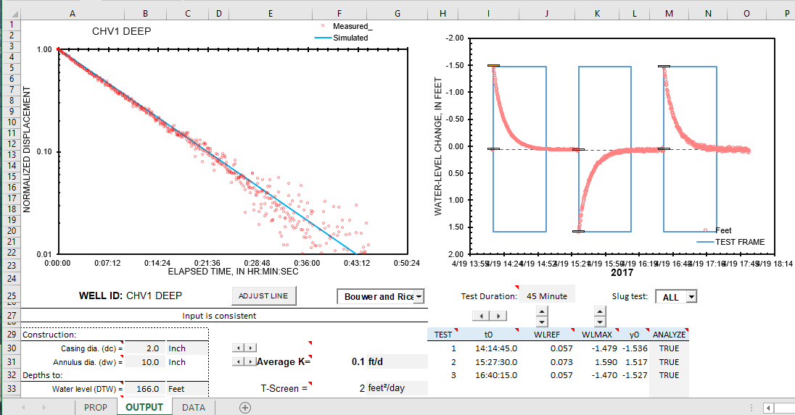
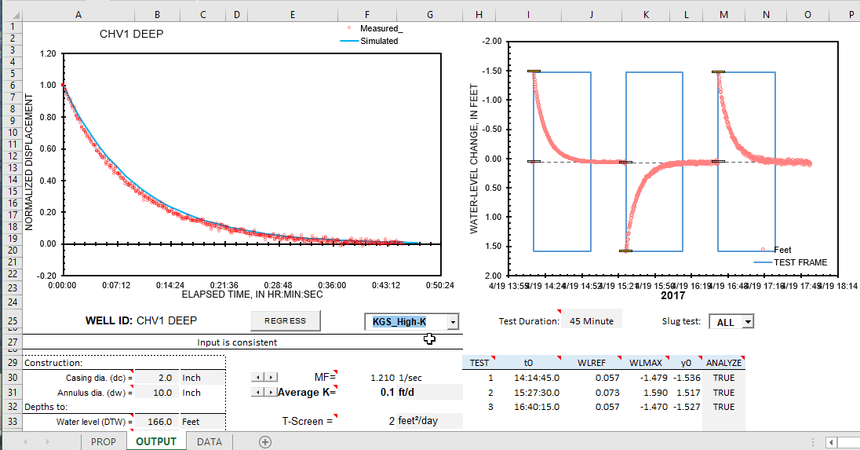
Slug_KGS-BnR-2019.xlsm
Revised for Bouwer&Rice and KGS
  https://halfordhydrology.com/slug_kgs-bnr-2019/

Slide 14
Constant Rate

Slide 15
Purpose
Estimate representative hydraulic properties
  Transmissivity (T)
  Storage Coefficient (S)
    Confined – Specific storage x thickness
    Unconfined – Specific yield
Area investigated
  Volume of pumped water
  Detection limit of drawdowns
Detail ∝ Observation Wells

Slide 16
Stress & Observe
Pumping creates stress
  Volume pumped known—Estimating T & S doable
  Steady & clear signal best—Negates noise
Water-level changes are observed
Drawdowns are,
  differences between observed water levels and what water levels would have been in the absence of pumping
  NOT necessarily, s = h – h₀
Keep observing—before, during, & afterwards

Slide 17
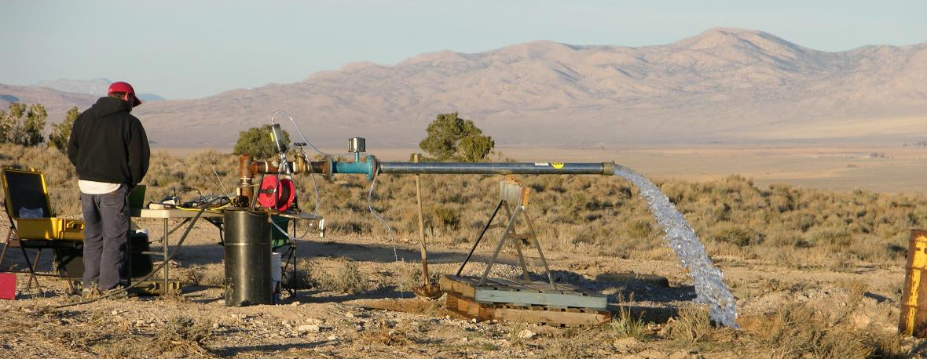
Volume Pumped
Q = 170 gpm
V =0.5 Mgal
Example, SW Big Springs well, Snake Valley
Pumped 170 gpm for 2 days, V = 500,000 gal.
Return flow not an issue
  355 ft to water & slope below site ~10%

Slide 18
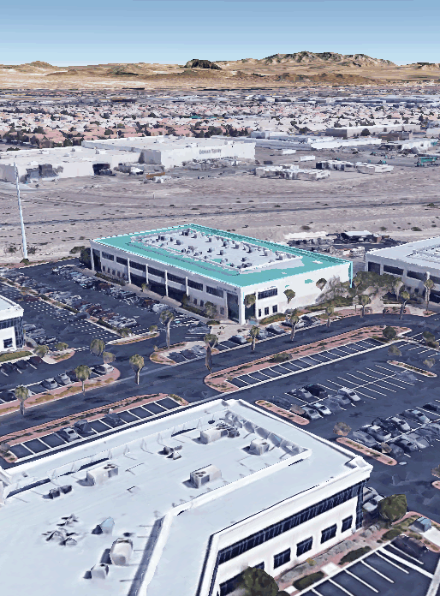
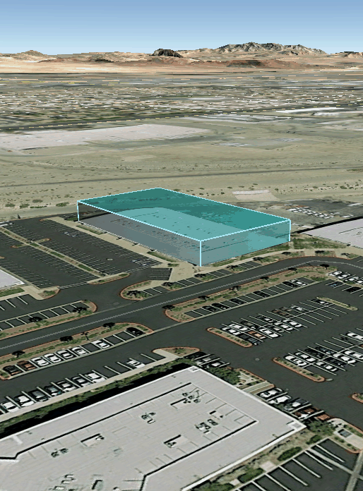
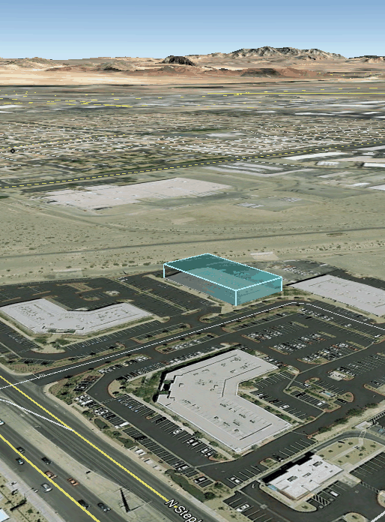
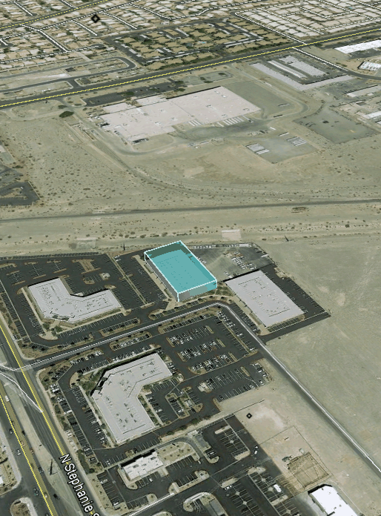
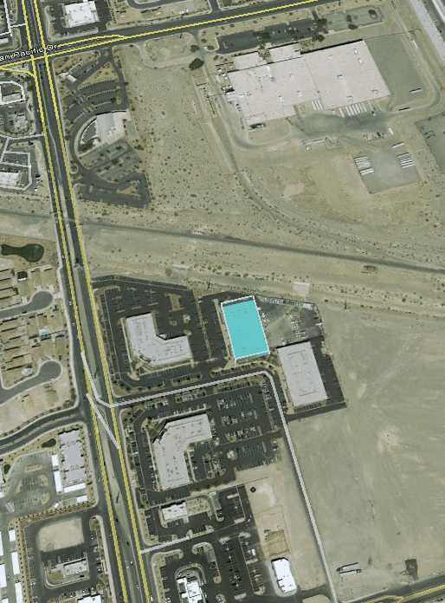
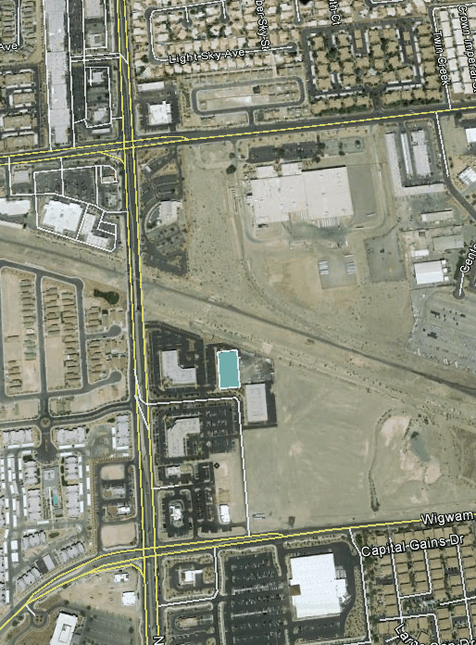
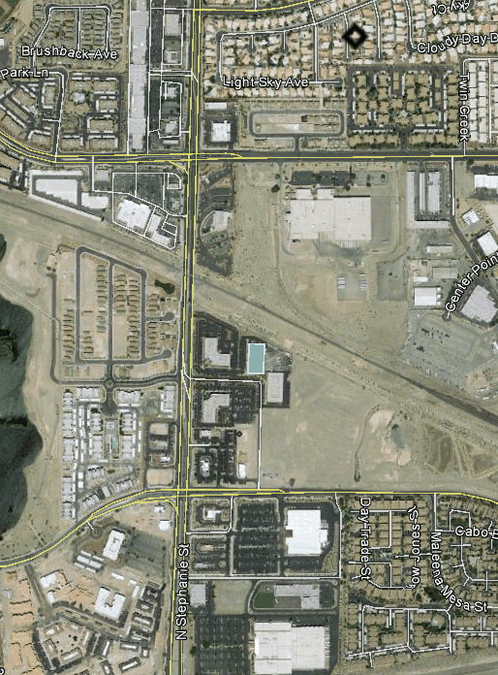
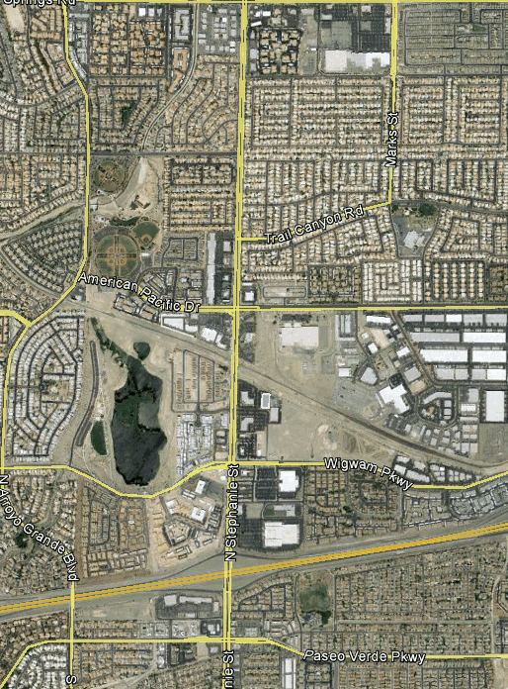
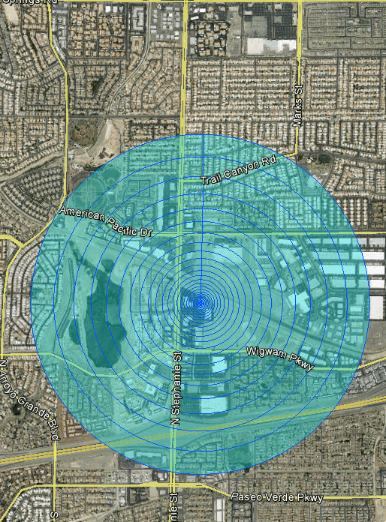
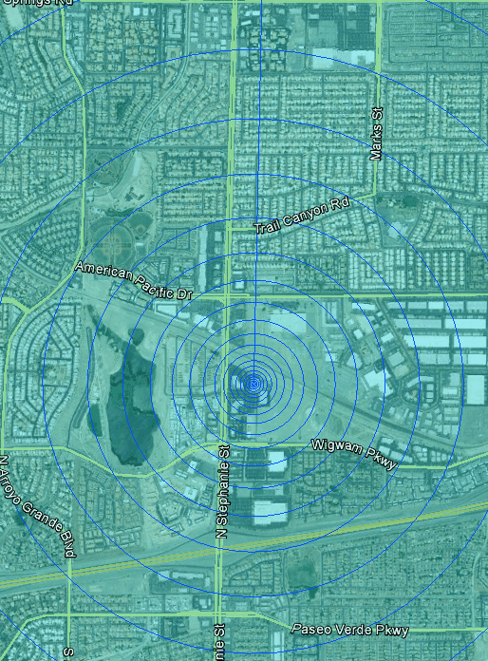
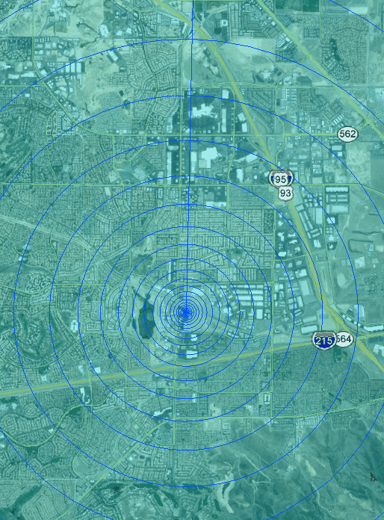
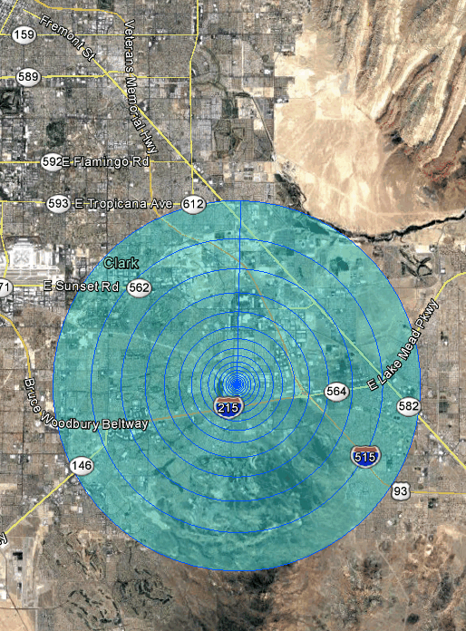
Volume Investigated
USGS office in Henderson
  6,000,000 gallons
  ~ Volume pumped several
  tests at Pahute Mesa
Aquifer defines thickness
  200 to 2,000 ft
Volume of rock bigger
  Transmissivity, complex
  Detection limit, 0.05 to 0.5 ft
  Storage coefficient
    Unconfined ~0.1
    Confined ~ 0.003
5 MILES
1 MILE

Slide 19
THEORY

Slide 20
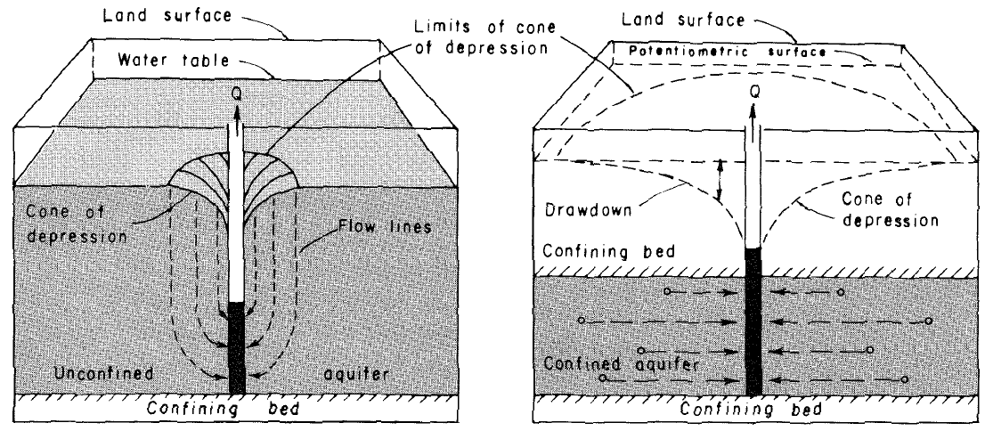
Simplifying Assumptions
(Heath, 1983)
Homogeneous & laterally isotropic
Flow patterns are radial, 3D >> 2D
Infinite extent of aquifer
Aquifer is of uniform thickness

Slide 21
Theis—Transient Flow
Theis solution, storage (S) is the only source of water
Additional assumptions:
  No wellbore storage – Line sink
  Water released from storage instantaneously
Drawdown is a function of
radial distance, time, T and S

Slide 22
Theis—Solution
Analytical solutions frequently solved in terms of dimensionless groups
W(u), well function, is exponential integral solution for Theis
Drawdown increased by increasing Q or decreasing T
Timing and magnitude of drawdown response equally affected by
  r², S, or 1 / T
Where,

Slide 23
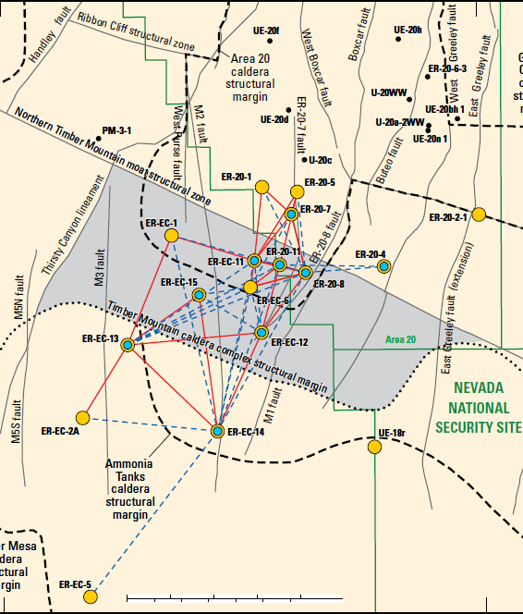
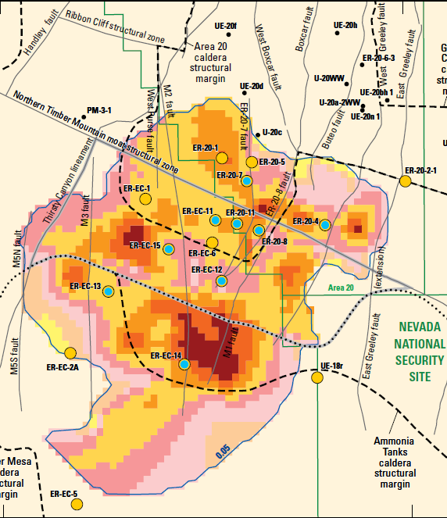
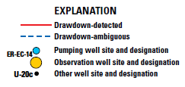
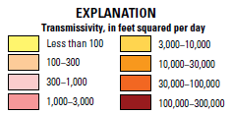
Numerical Models
Complex tests
  Many observation wells
  Multiple pumping wells
Homogeneous T & S cannot explain many overlapping pumping-drawdown pairs
Estimate hydraulic properties with numerical models
  Spatially variable hydraulic properties
(Garcia, et al, 2017)
5 MILES

Slide 24
REAL
WELLS

Slide 25

Constant Rate & Wells
Constant rate desirable
  Pump & observe with wells
Construction affects responses
  Wellbore storage
Skin defines all head losses
  Screen, gravel pack, & damage
Long well screens more likely to
  Be hydraulically connected
  Obfuscate vertical gradients
  Affected by aquifer heterogeneity
Be aware as one interprets
Casing
Grout
Gravel
Pack
Screen

Slide 26
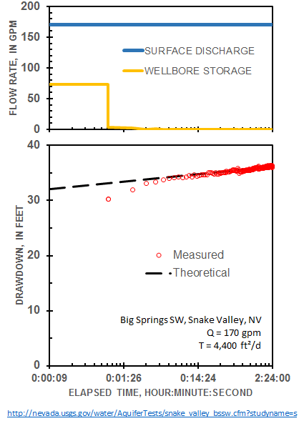
Wellbore Storage
Refers to pumping well
First production from well
  Unit Vol. = casing – drop string
For example,
  Casing diameter = 8 in.
  Drop diameter = 4 in.
  Unit Volume = 2 gallons/ft
Significance increases
  Low pumping rate
  Low transmissivity

Slide 27
Observation Well Storage
TIME
Q
Similar to reversed slug test
Water level in aquifer “suddenly” changes, well lags
Unconfined aquifer responds slowly, prolongs wellbore storage
Lag period increases as
  Well diameter increases
  Shorter screen
  Completion is cruddier—More skin
  Low-K lens of silt/clay
(Halford, 1998)

Slide 28
Effect on Results
Typical S_{S} values for
  Water 1.4 x10⁻⁶ ft ⁻¹
  Aquifer ~2 x10⁻⁶ ft ⁻¹
Estimated S_{S} ~10–100 x10⁻⁶ ft ⁻¹
Hydraulic conductivity unaffected
Could pack-off well, but don’t
Ignore meaningless S_{S} estimates

Slide 29
Long Well Screens
Well is not passive
Vertical gradients induce flow
Flow magnitude increases with K and screen length
Water level weighted towards highest transmissivity
Interpret as if well completed in just transmissive material
r_{w}
r_{e}
K1
K₁
K₂

Slide 30
SINGLE-WELL
AQUIFER TESTS

Slide 31
Single-Well Pumping
Estimate transmissivity opportunistically
Relatively independent of well construction
  Inefficient wells increase uncertainty
  Magnifies response to small changes in Q
Simple analysis
  Fit a straight line
Encountered most frequently, NV ~ 80%

Slide 32
Cooper-Jacob
Solution to W(u) is a series
If u is small, drawdown ∝ ln(u)
Straight line on a semi-log plot OK answer
For 1/u > 50
W(u) = -0.5772 – ln(u)

Slide 33
Cooper-Jacob Analysis
Transmissivity estimated with
  Slope &
  Discharge
Eyeball slope
Ignore first 10 minutes
  Wellbore storage
  Skin
  Partial penetration

Slide 34
Storage Coefficient—BAD
Storage coefficient
  Can be estimated
  Cannot be trusted
Time intercept for S
Skin & partial penetration
  Increases drawdown
  Shifts time intercept
  Storage coefficient grossly underestimated
PUMPING WELL

Slide 35
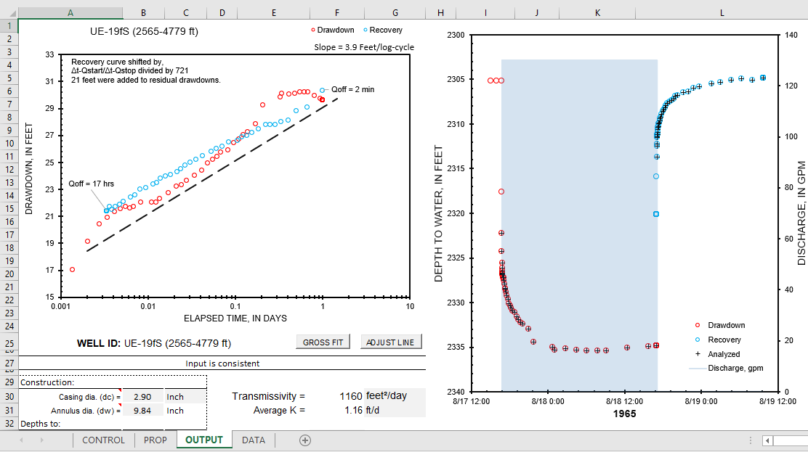
Workbook Analysis
Combines Cooper-Jacob pumping and recovery analysis
  Separate workbooks in Halford and Kuniansky (2002)
  Improved data handling, https://halfordhydrology.com/cj-drawdownrecovery/

Slide 36
REPORT
TRANSMISSIVITY

Slide 37
Transmissivity & K
K = T / b
Transmissivity
  Estimated quantity,
  not hydraulic conductivity
  Unknown thickness, OK
  Whole aquifer where,
  T greater than 3,000 ft²/d
Thickness, b, differs
  Depth Drilled
  Screen Length
  Model Thickness
T = K x b
K_{BASIN FILL}
b
K_{CARBONATE}
CONFINING UNIT
Transmissivity,
Estimate unchanged!

Slide 38
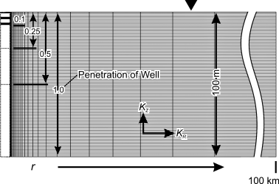
Interpretation of Transmissivity
Test with numerical models—Transmissivity known
Cooper-Jacob investigated by interpreting 628 simulated drawdowns
Known transmissivity estimated with Cooper-Jacob
  Transmissivity 10 to 10,000 m²/d
  Specific storage 5 x 10⁻⁶ m⁻¹
  Specific yield 0.05 to 0.3
  Vertical anisotropy 0.02 or 0.2
  Partial penetration 10% to 100%
(Halford, et al, 2006)

Slide 39
Confined Aquifers
Transmissivity of aquifers estimated
Unambiguously,
K = T / b, T > 50 m²/d
  Aquifer thickness
  NOT screen length
K = T / Screen length, where, T < 5 m²/d

Slide 40
Unconfined—Just T
Unconfined solution non-unique
  Response similar to dual-porosity & other solutions
Transmissivity—GOOD, Report T
All other parameters —BAD

Slide 41
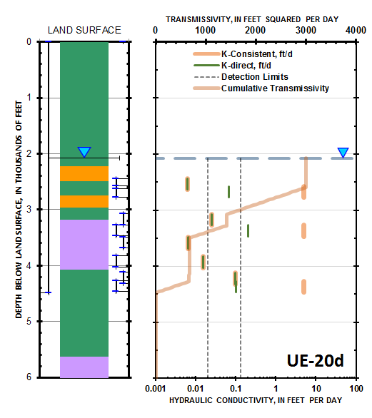
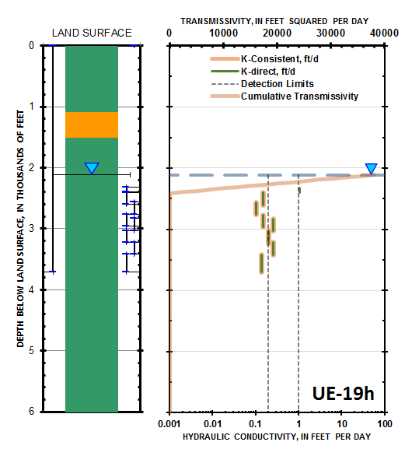
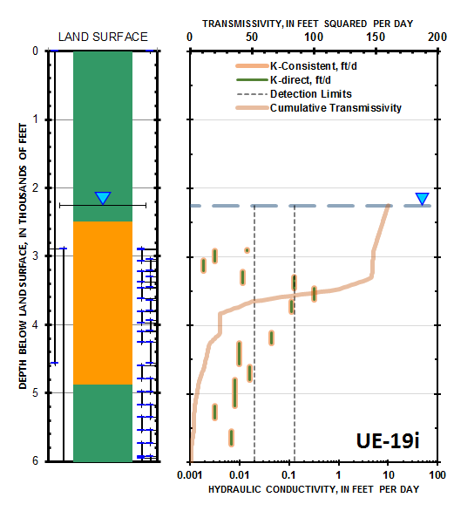
Aquifer Unknown
Transmissivity known,
Need more to reduce to K
Thickness (b) needed
  Some ambiguity, basin fill
  Problem great, hard rocks
Lithologic classification & hydraulics disagree
Reducing to K bad, where
b aquifer test & b model differ
  T = 40,000 ft²/d, UE-19h
  b = 200 ft, packer tests
  K = 200 ft/d, reported
  b = 4,000 ft, model
  T = 800,000 ft²/d, model
Avoid badness,
Report transmissivity (T)
Confining
Unit
Aquifer
Confining
Unit
Composite
Unit
Aquifer
Aquifer
(Frus and Halford, 2018)

Slide 42
DRAWDOWN
DETECTION

Slide 43
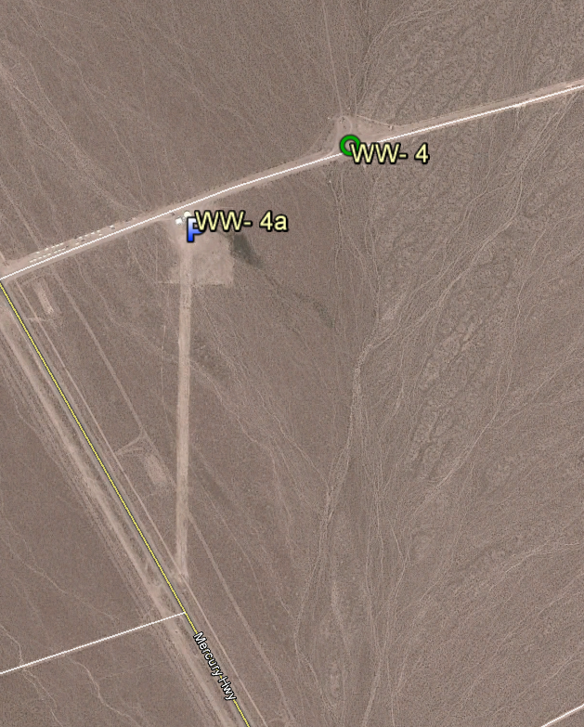
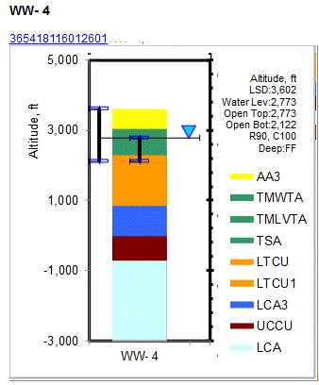
Other Signals
Well WW4a pumps
Analyze response in well WW4 at Nevada Test Site,
r = 1,200 feet
Dual-porosity response clearly present
1200 FEET

Slide 44
Noise & Interpretation
WW4a is production well, cycles to fill tank
Repeat pumping, should repeat responses
Interesting responses unrepeatable
Earth tides & barometric effects bulk of “interesting” responses
Monitor much more than pumping period

Slide 45
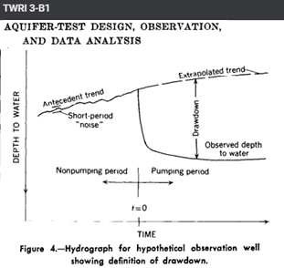
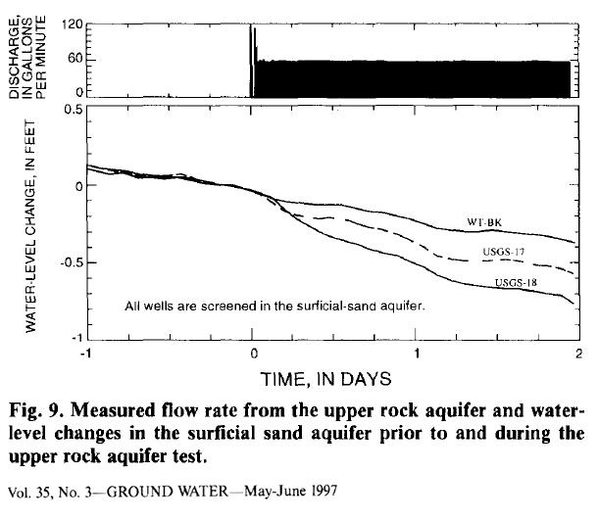
Ageless Problem
(Stallman, 1971)
Measured water levels sum
  Drawdown &
  Environmental fluctuations
Estimate water levels had pumping not occurred
Limited corrections
  Extrapolate trend
  Background well close
Ignore short-period “noise”
(Halford, 1997)

Slide 46
Drawdown Detection
Estimate drawdown
  Great distance
  Adjacent aquifers
  High transmissivity
Detecting small changes difficult
Requires water-level modeling
PUMPING
PERIODS

Slide 47
Water-Level Modeling
Sum possible sources
Natural signals
  Tides
  Barometer
  Background water levels
Natural components can be correlated
Pumping
  Superimpose Theis
  Transform function
  T & S limited to no value
Theis Transform
Synthetic water levels

Slide 48
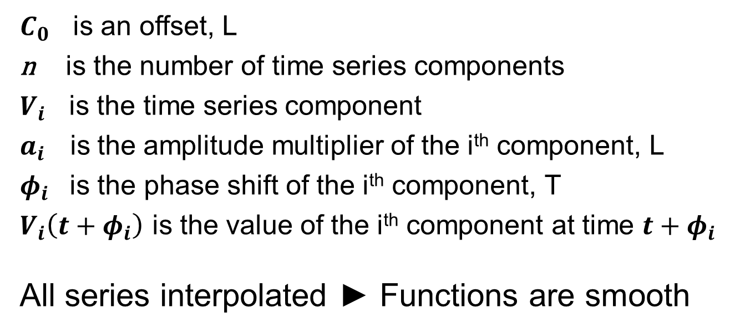
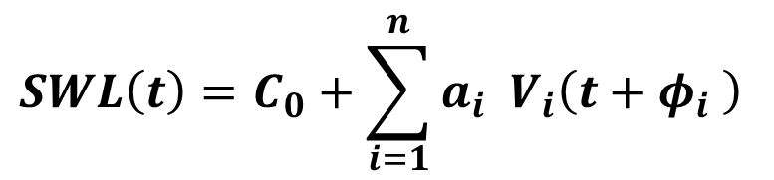
Synthetic Water Levels
Estimated
$$SWL\left(t\right)=C_{0}+\sum_{i=1}^{n}{a_{i}{ V}_{i}\left(t+φ_{i} \right)}$$
$C_{0}$ is an offset, L
n is the number of time series components
$V_{i}$ is the time series component
$a_{i}$ is the amplitude multiplier of the i^{th} component, L
$φ_{i}$ is the phase shift of the i^{th} component, T
$V_{i}\left(t+φ_{i}\right)$ is the value of the i^{th} component at time $t+φ_{i}$
All series interpolated ► Functions are smooth

Slide 49
Water-Level Modeling
1.5
Pumping
1.0
WATER LEVEL CHANGE, IN FEET
0.5
0.0
EarthTide
Measured
GravityTide
Barometer
Synthetic
Barometer Avg 1d
Barometer Avg 7d
Drawdown
Background
Theis Transform
Background Avg 1d
-0.5
04/08
04/15
04/22
04/29
05/06
05/13
05/20
05/27
06/03
06/10
Fit measured water levels
Adjust amplitude and phase each series
Drawdown = Theis Transform - Residuals

Slide 50
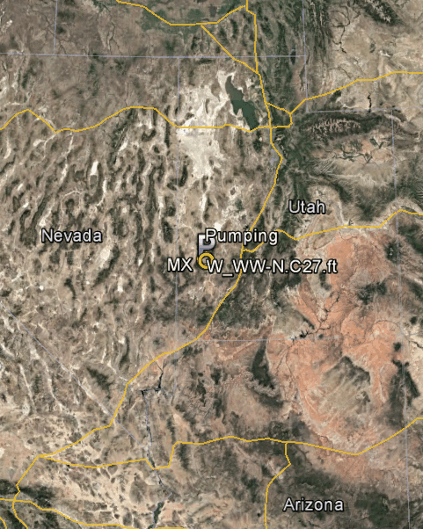
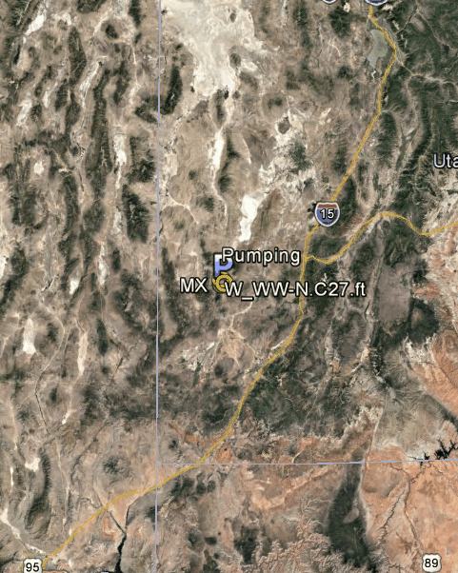
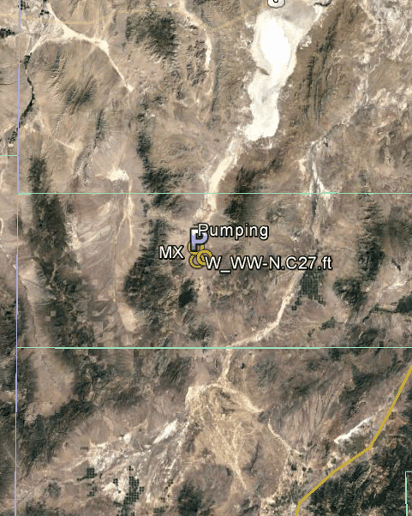
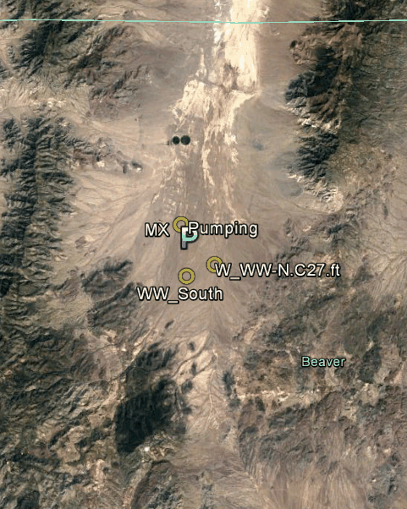
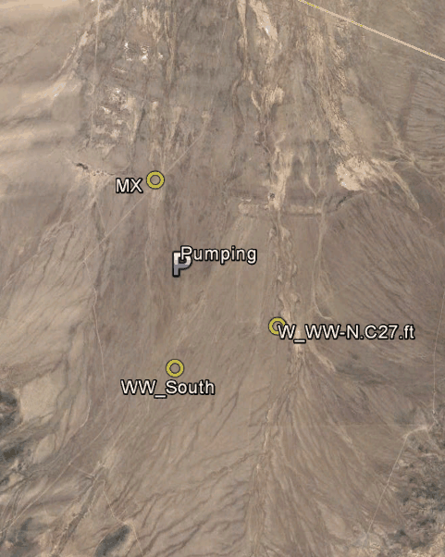
Wah Wah Valley, Utah
Estimate T & S
for groundwater development
Use existing wells
  > 1 mile apart
Pump
  1,200 gpm
  1 week
7800 FEET
(Gardner, et al, 2020)

Slide 51
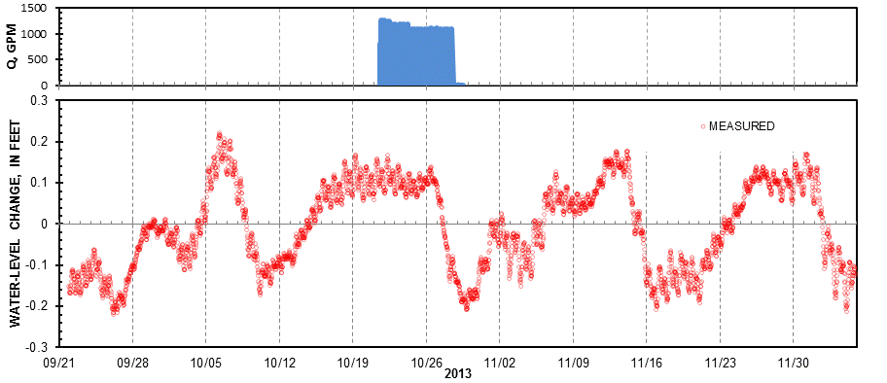
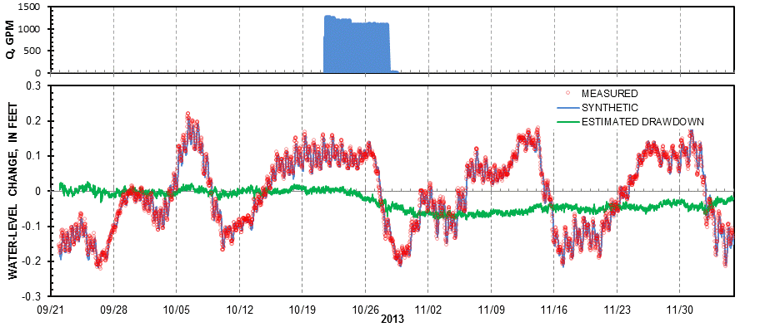
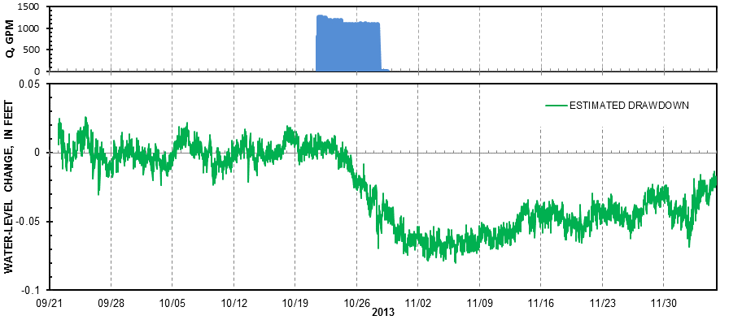
Mostly Monitoring
Peak Displacement
Ample monitoring makes results possible
Maximum drawdown, 1 week after pumping ceases
Pumping period small relative to required record
  Small drawdown plausible because of antecedent fit

Slide 52
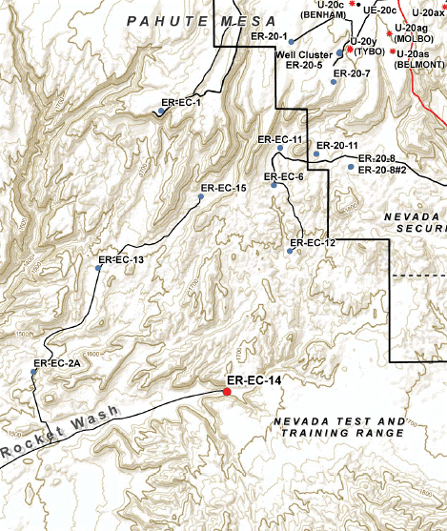
Expanded Volume
Pumped ER-EC-13
2 aquifer tests
  Upper zone, 8E6 gal
  Lower zone, 6E6 gal
Detected 2-3 miles
Maximum drawdown
  ~1 inch
High confidence
in results
  Repetition w/ 2 tests
  Antecedent & recovery data, lots
ER-EC-13
Upper &
Lower
6 MILES
(Garcia, et al, 2017)

Slide 53
REPORTING

Slide 54
Reporting
Aquifer-test results are interpretive
Good average typically, not overly precise
  1 significant figure is truthful
Cover basics & convince reader,
“OK, these estimates are plausible”
Necessary parts listed & explained
  USGS OGW Technical Memorandum 2009.01
  https://water.usgs.gov/admin/memo/GW/gw09.01.html

Slide 55
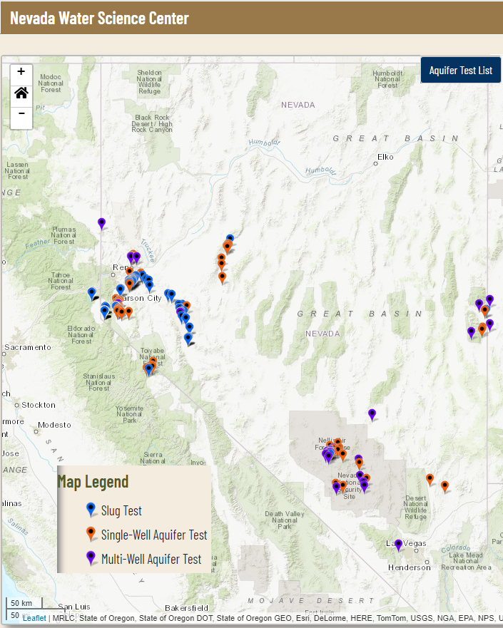
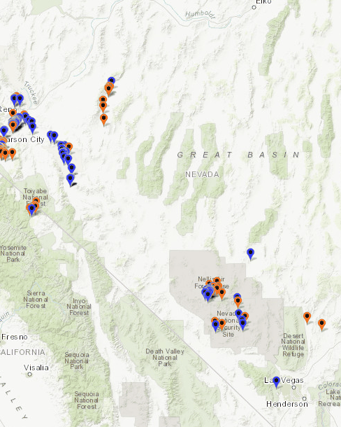
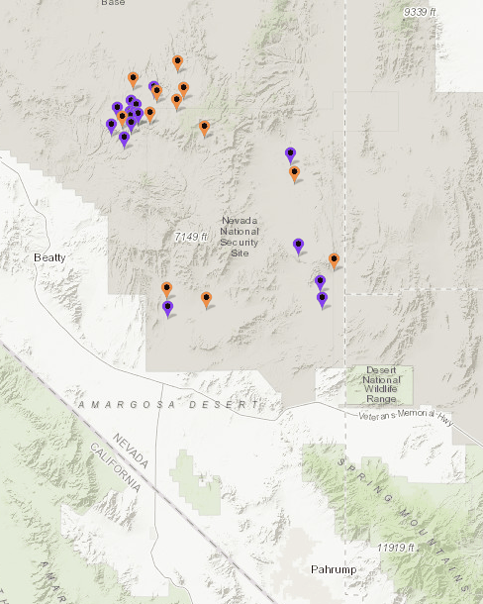
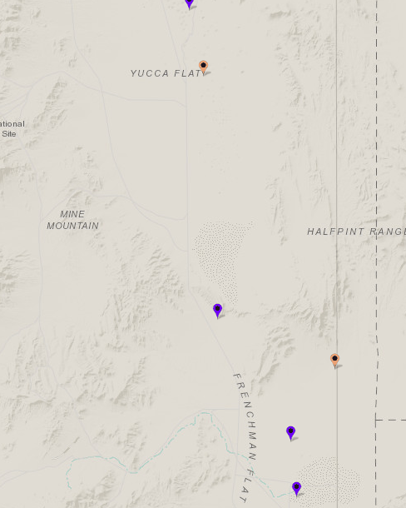
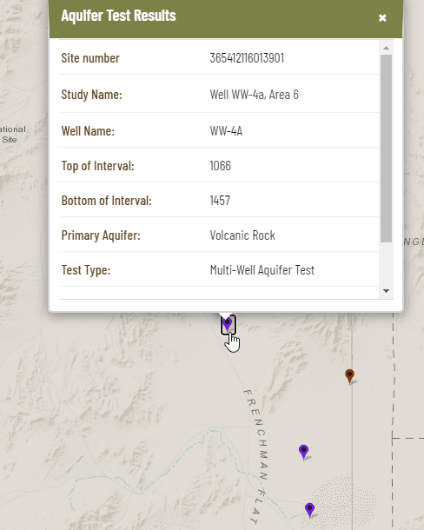
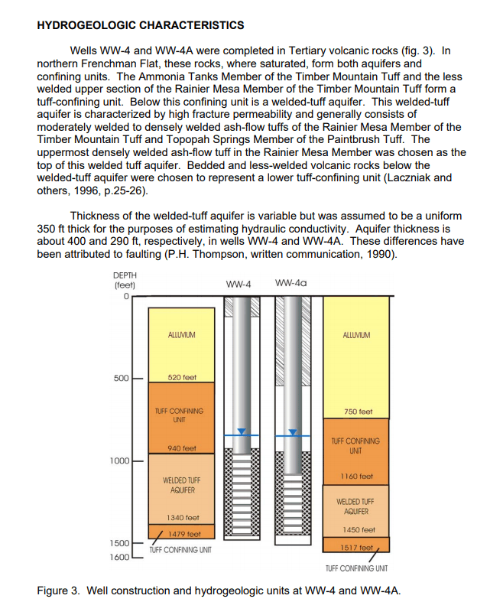

USGS Aquifer Tests Nevada
Aquifer test examples
  Representative hydraulic properties
  Many examples of reporting
    Slug tests
    Single-well tests
    Multiple-well tests
Search for title or link,
https://nevada.usgs.gov/aquifertests/index.html

Slide 56
USGS GW Memo 2009.01
Briefly describe test—Purpose, date, data collection procedures, and methods of analysis.
Sketch test site—Show wells & hydraulic features, streams, springs, ditches, other pumping wells
Report well construction & local geohydrology
Show complete time-discharge records
Show hydrographs—before, during, & after pumping
Estimate drawdowns from water levels
Show plots of observed or adjusted drawdown data used to determine hydraulic characteristics

Slide 57
References
Ferris, J.G.; Knowles, D.B.; Brown, R.H.; Stallman, R.H., 1962, Theory of aquifer tests, USGS Water Supply Paper: 1536-E, http://pubs.er.usgs.gov/publication/wsp1536E
Stallman, Robert W., 1971, Aquifer-test design, observation, and data analysis, USGS Techniques of Water-Resource Investigation: 03-B1, http://pubs.usgs.gov/twri/twri3-b1/
Heath, Ralph C., 1983, Basic ground-water hydrology, USGS Water Supply Paper: 2220, http://pubs.er.usgs.gov/publication/wsp2220
USGS, 1994, Guidance for the preparation, approval, and archiving of aquifer-test results, OGW Technical Memorandum 94.02, http://water.usgs.gov/admin/memo/GW/gw94.02.html
Merritt, Michael, L., 2004, Estimating Hydraulic Properties of the Floridan Aquifer System by Analysis of Earth-Tide, Ocean-Tide, and Barometric Effects, Collier and Hendry Counties, Florida: USGS WRI Report 03-4267, http://pubs.usgs.gov/wri/wri034267/
Halford, K. J., Weight, W. D. and Schreiber, R. P., 2006, Interpretation of Transmissivity Estimates from Single-Well Pumping Aquifer Tests. Groundwater, 44:467–471,
http://onlinelibrary.wiley.com/doi/10.1111/j.1745-6584.2005.00151.x/abstract;jsessionid=1EBB9DAF6218A74AC389F630050FEB37.f03t01
USGS, 2009, Update on Guidance for the Preparation, Approval, and Archiving of Aquifer-Test Results, OGW Technical Memorandum 2009.01, https://water.usgs.gov/admin/memo/GW/gw09.01.html
Halford, K., Garcia, C.A., Fenelon, J., and Mirus, B., 2012, Advanced methods for modeling water-levels and estimating drawdowns with SeriesSEE, an Excel add-In, U.S. Geological Survey Techniques and Methods 4–F4, http://pubs.usgs.gov//tm/tm4-F4/
Garcia, C.A., Jackson, T.R., Halford, K.J., Sweetkind, D.S., Damar, N.A., Fenelon, J.M., and Reiner, S.R., 2017, Hydraulic characterization of volcanic rocks in Pahute Mesa using an Integrated Analysis of 16 multiple-well aquifer tests, Nevada National Security Site, 2009–14: U.S. Geological Survey Scientific Investigations Report 2016-5151, 62 p., https://doi.org/10.3133/sir20165151
Frus, R.J., and Halford, K.J., 2018, Documentation of single-well aquifer tests and integrated borehole analyses, Pahute Mesa and Vicinity, Nevada: U.S. Geological Survey Scientific Investigations Report 2018–5096, 22 p., https://doi.org/10.3133/sir20185096
Halford, K.J., and Jackson, T.R., 2020, Groundwater characterization and effects of pumping in the Death Valley regional groundwater flow system, Nevada and California, with special reference to Devils Hole: U.S. Geological Survey Professional Paper 1863, 178 p., https://doi.org/10.3133/pp1863
Gardner, P.M., Marston, T.M., Buto, S.G., and Brooks, L.E., 2020, Hydrogeologic and geochemical characterization of groundwater resources in Pine and Wah Wah Valleys, Iron, Beaver, and Millard Counties, Utah: U.S. Geological Survey Scientific Investigations Report 2019–5139, 49 p., https://doi.org/10.3133/sir20195139

